Slide 1
Knowledge Workers
Berlin KM Meetup Group
February 8, 2017
Compiled by Stephanie Barnes
February 1, 2017
stephanie.barnes@missingpuzzlepiececonsulting.com

Slide 2
Agenda
Definition
Who are knowledge workers
How to motivate them
What role do knowledge workers have in knowledge management
Open discussion

Slide 3
Knowledge Workers
First coined by Peter Drucker in 1957
Definition:
Knowledge workers are workers whose main capital is knowledge
Knowledge work can be differentiated from other forms of work by its emphasis on "non-routine" problem solving that requires a combination of convergent, divergent, and creative thinking. But despite the amount of research and literature on knowledge work, there is no succinct definition of the term
Source: Wikipedia, accessed Feb 1, 2017, 17:00 CET, https://en.wikipedia.org/wiki/Knowledge_worker

Slide 4
Who are they?
Software engineers, physicians, pharmacists, architects, engineers, scientists, consultants, accountants, lawyers, and academics, anyone whose job is thinking for a living
Even jobs that may seem to have a significant manual component to them, like working on an assembly line or parcel delivery often have a knowledge component to them

Slide 5
How to motivate knowledge workers
Challenging work
Creating a work culture permitting relative autonomy
Celebrating achievement
Developing a sense of purpose
Direction and excitement
Willingness to share gains
Effective communications
Concern for people by respecting the dignity of the individual
Providing enabling resources (such as new technology)
Enabling employees to acquire skills to increase their employability in both internal and external labour markets
Source: “Finders, keepers? Attracting, motivating and retaining knowledge workers”
Frank M. Horwitz, University of Cape Town, South Africa, Chan Teng Heng and Hesan Ahmed Quazi, Nanyang Technological University, Singapore
Human Resource Management Journal, Vol 13 No 4, 2003, pages 23-44

Slide 6
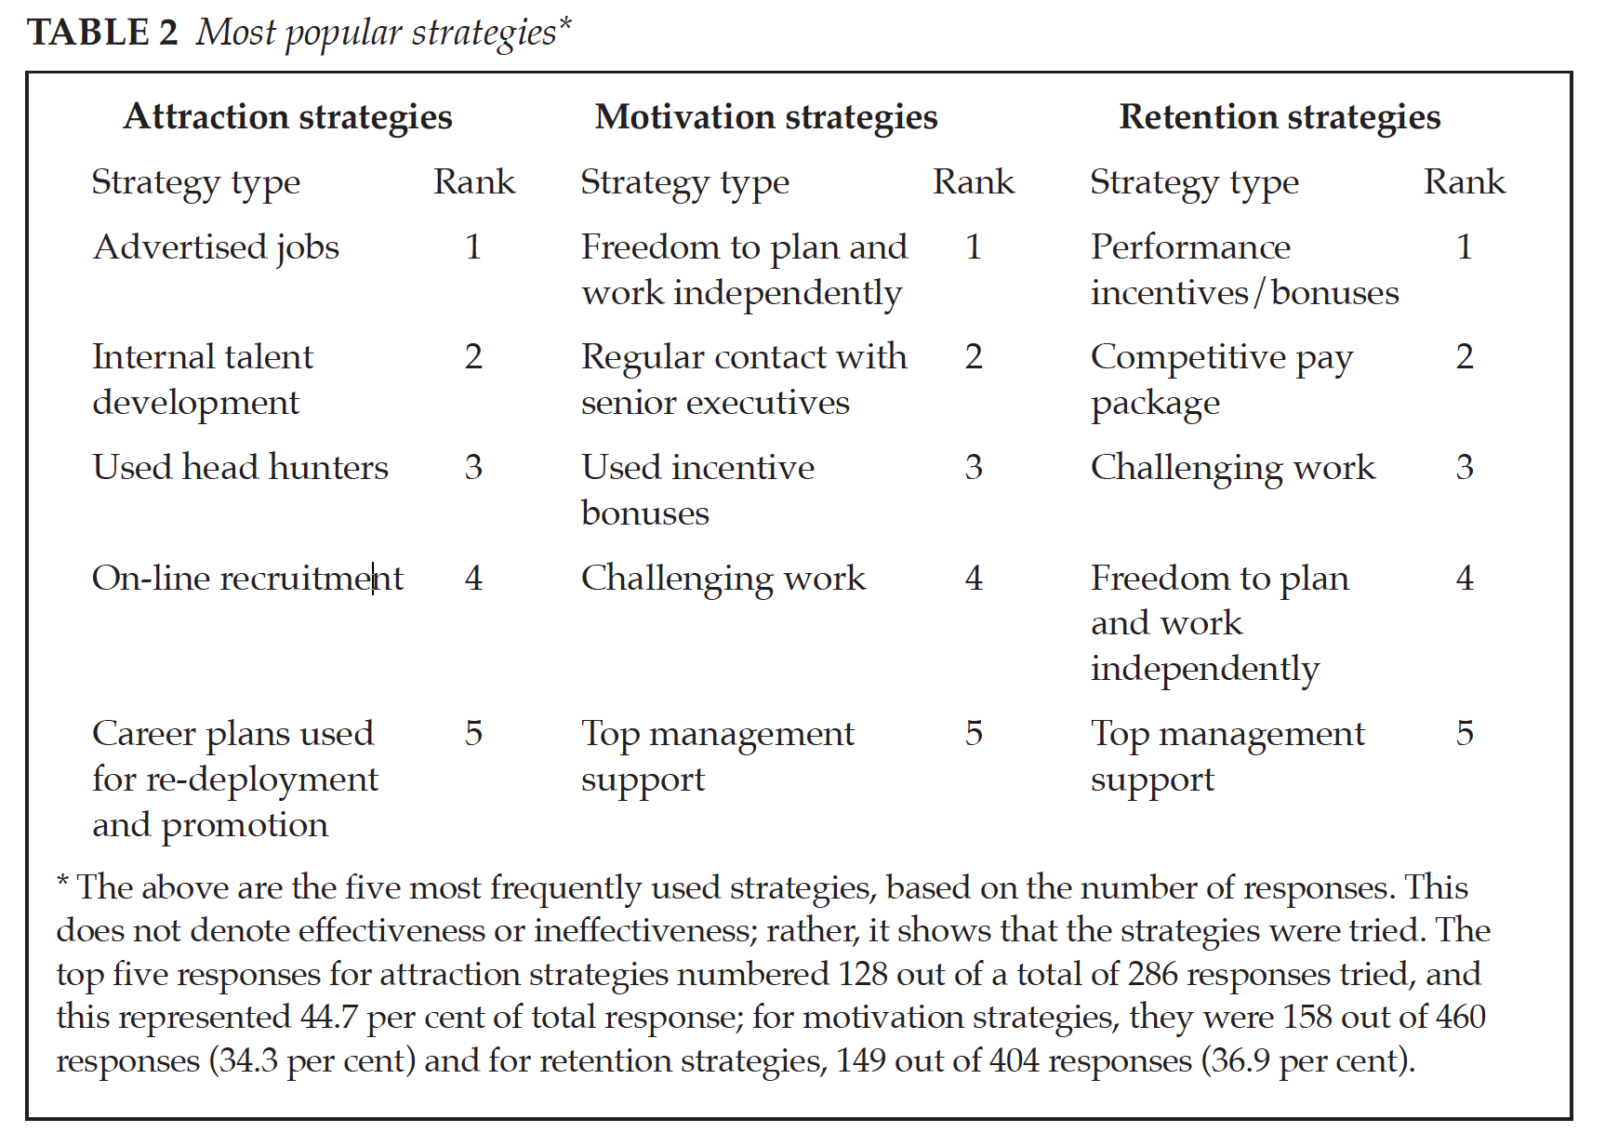
How to motivate knowledge workers
Source: “Finders, keepers? Attracting, motivating and retaining knowledge workers,” Frank M. Horwitz, University of Cape Town, South Africa, Chan Teng Heng and Hesan Ahmed Quazi, Nanyang Technological University, Singapore, in Human Resource Management Journal, Vol 13 No 4, 2003, page 31.

Slide 7
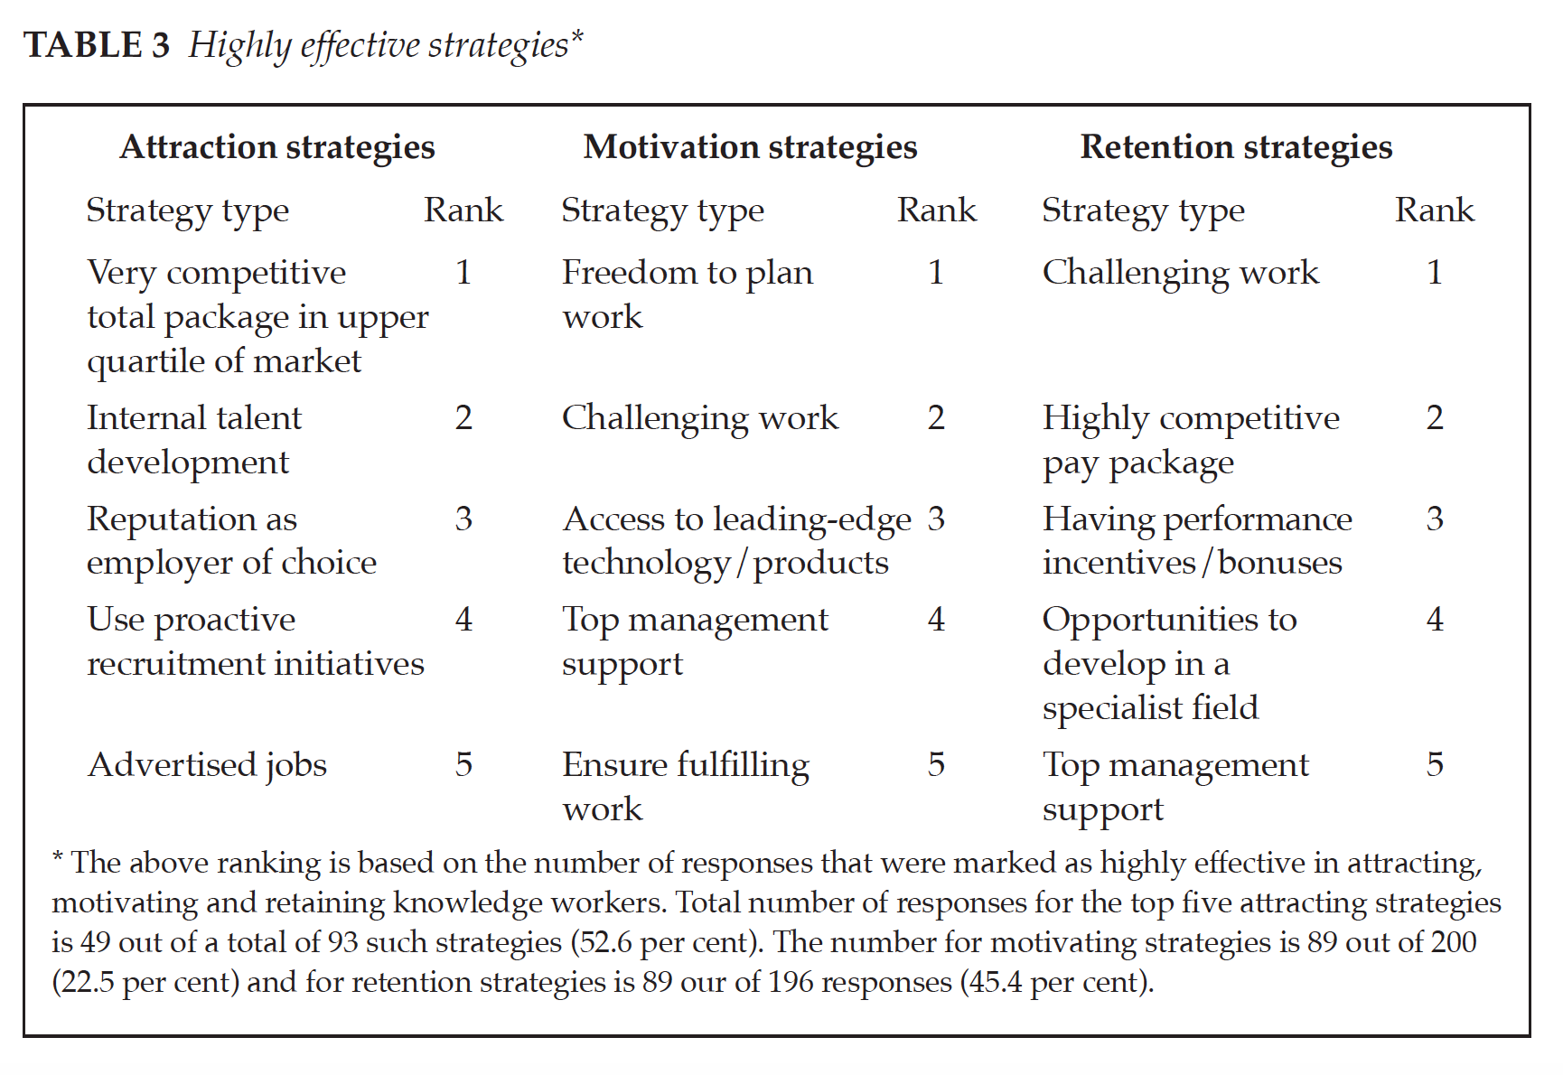
How to motivate knowledge workers
Source: “Finders, keepers? Attracting, motivating and retaining knowledge workers,” Frank M. Horwitz, University of Cape Town, South Africa, Chan Teng Heng and Hesan Ahmed Quazi, Nanyang Technological University, Singapore, in Human Resource Management Journal, Vol 13 No 4, 2003, page 32.

Slide 8
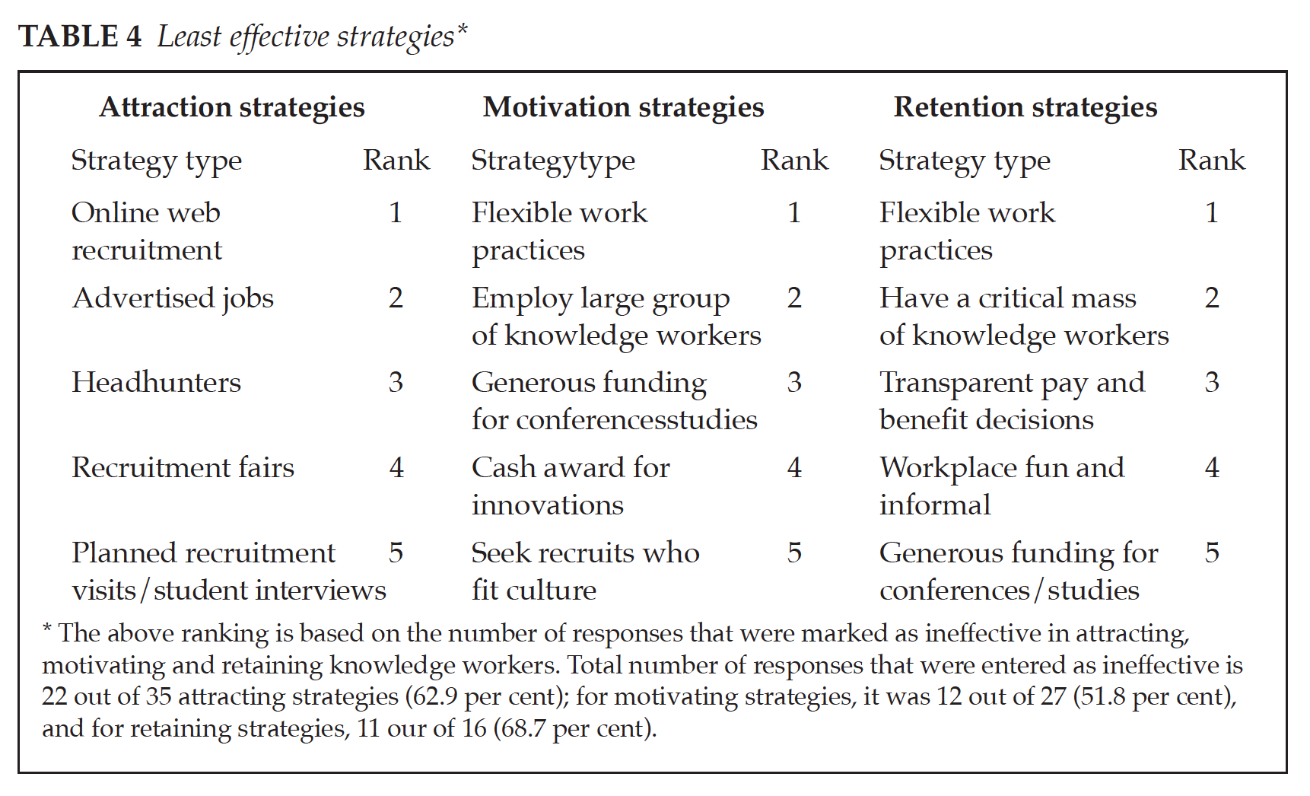
How to motivate knowledge workers
Source: “Finders, keepers? Attracting, motivating and retaining knowledge workers,” Frank M. Horwitz, University of Cape Town, South Africa, Chan Teng Heng and Hesan Ahmed Quazi, Nanyang Technological University, Singapore, in Human Resource Management Journal, Vol 13 No 4, 2003, page 32.

Slide 9
Knowledge Worker Roles: Knowledge Management Program
Governance Committee
Cross-functional team
Knowledge Management Program Team
Knowledge Management Champions
Managers
Knowledge Manager
Knowledge Management Process Owner
Individual
Advocate and promote the benefits of pursuing
Support knowledge management policies
Provide advice, best practice guidance and training on Knowledge Management
To promote the values of Knowledge Governance
To monitor, evaluate, evolve knowledge management practices
The accountable person within the organization who owns the KM Process and is responsible for its implementation, performance, and maintenance, as well as governance and standards
Ensures that they create and maintain appropriate records in relation to their work and to manage those records in accordance with the organization’s information/document management policies and procedures
Helps to institutionalize Knowledge Management in the organization; they are team-based KM subject matter experts

Slide 10
Knowledge Worker Roles: Documented Knowledge Lifecycle
Approvers
endorse the accuracy of the content and format of a document/knowledge artefact, this group should include the document owners and support providers where applicable
Collaborators
work with Creators to develop the content and format of a document/knowledge artefact
Creator
bringing knowledge or documents into existence for the first time.
Knowledge Management Process Owner
the accountable person within the organization who owns the KM Process and is responsible for its implementation, performance, and maintenance, as well as governance and standards
Knowledge Managers
helps to institutionalize Knowledge Management in the organization; they are team-based KM subject matter experts. This role is responsible for managing/maintaining the process
Managers
someone who over-sees staff, can also apply to Project Managers
Owner
responsible for the up-keep of a document after it has been created. The role of Owner is a new role/concept for the organization, and in some cases will be the same as the creator, while in other situations it may be someone else
Publishers
post a document/knowledge artefact to a knowledge repository
Reviewers
assess the content of a document/knowledge artefact, should include staff who will be using the document, especially if it is a support/operational document
Users
draw on the content of a document/knowledge artefact as part of their job responsibilities

